Slide 1


Analysis of Genomic
Copy Number Alterations
Bastien Job - INSERM / Gustave Roussy
École de bioinformatique AVIESAN-IFB n2 2021

Slide 2
DNAseq Workflow
Reads (Fastq)
Variants Structuraux
Fastq Quality Control
-- FastQC --
Reference genome (Fasta)
Mapping
-- Bowtie2/Bwa --
Processing Post Alignement
Variant Calling
Filtrage & Annotation
Copy Number

Slide 3
Copy Number Alteration Workflow
Captured regions (BED)
Precomputed GC% profile
Precomputed “Wave” profile
Mapped reads
TEST (BAM)
Binning
-- WES.Bin --
Normalization
-- WES.Normalize.ff --
L2R+BAF
segmentation
-- Segment.ff --
Mapped reads
REF (BAM)
Report rendering
-- Annotate.ff --
Absolute copy-number modelization
-- ASCN.ff --
Notes:
GO SLIDE 9

Slide 4
A bit of vocabulary
"CNV" (Copy Number Variation) includes :
"CNA" :
Copy Number Anomaly
Copy Number Alteration
Copy Number Aberration
Copy Number Abnormality
Large-scale (> 1Kb) polymorphisms (often called … "CNV")
‹#›

Slide 5
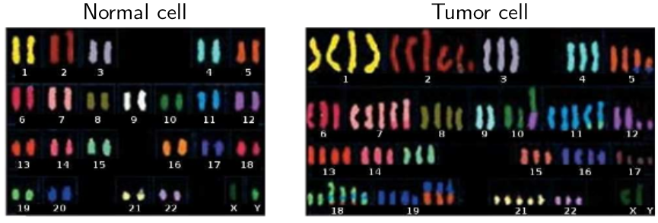
Copy Number Alterations (and Cancer)

Slide 6
Copy Number Alterations (and Cancer)

Slide 7
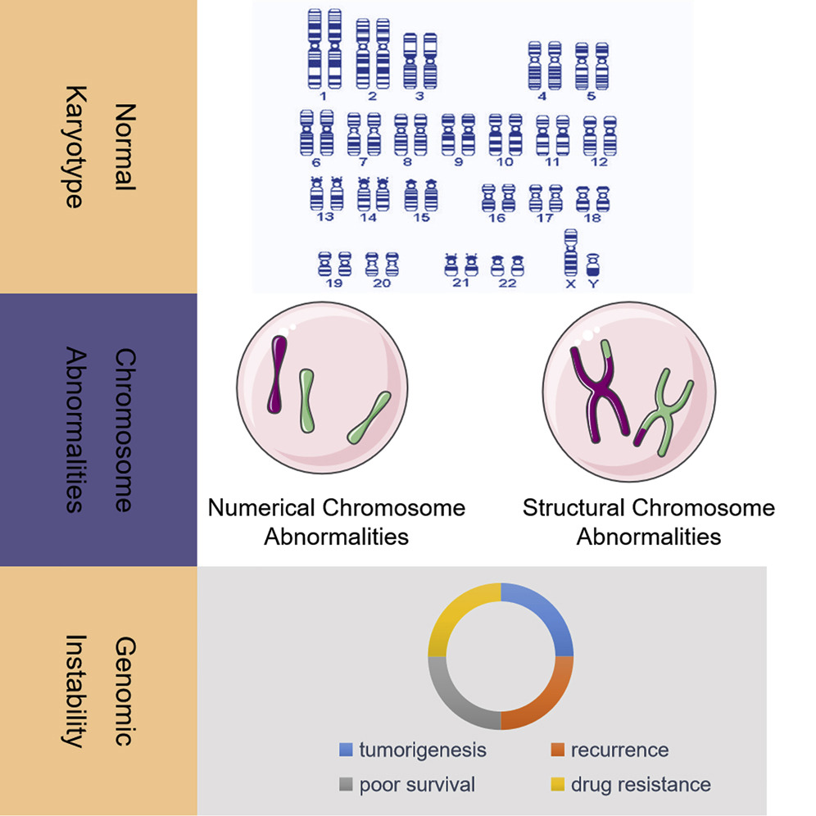
Copy Number Alterations (and Cancer)

Slide 8


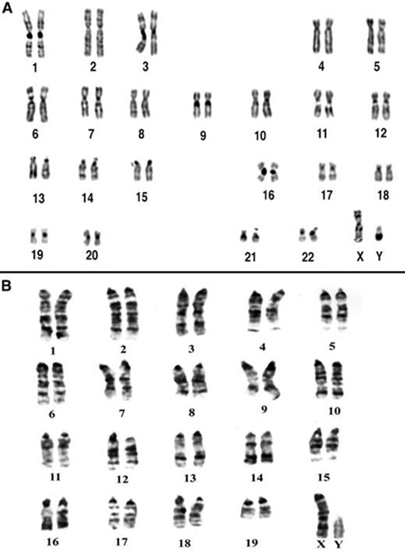
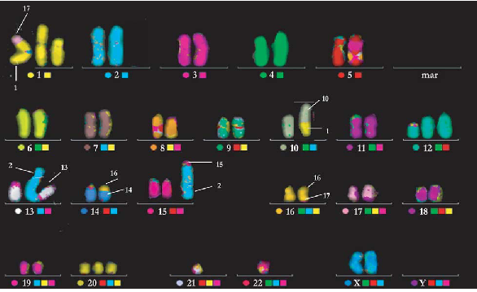
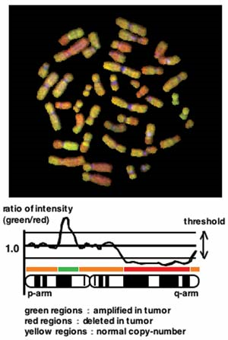
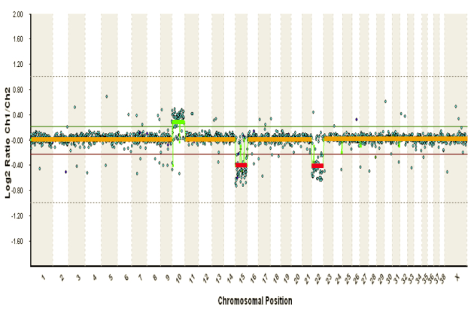
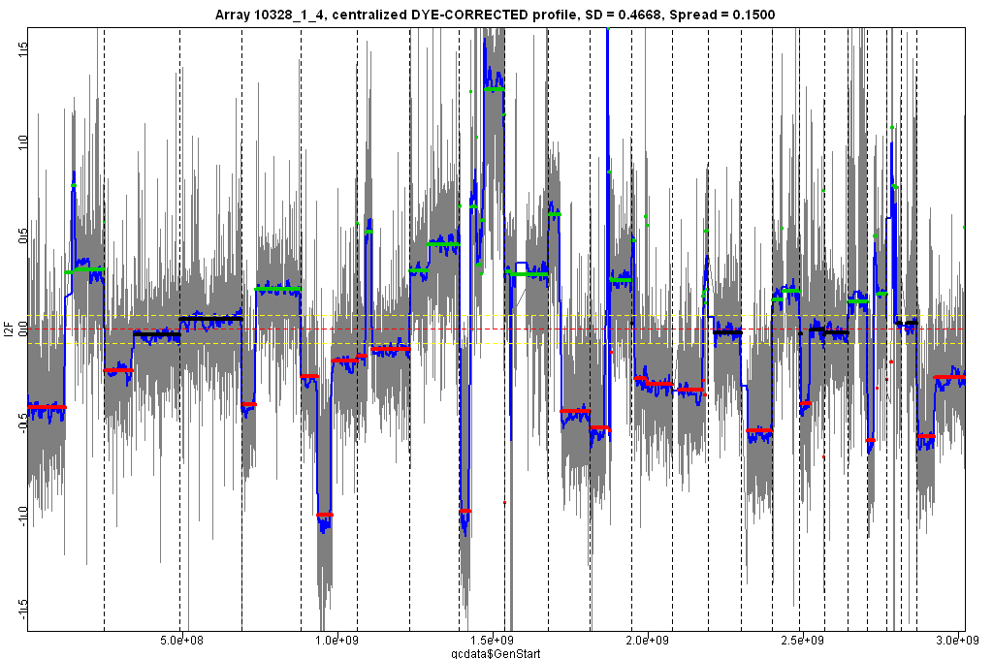
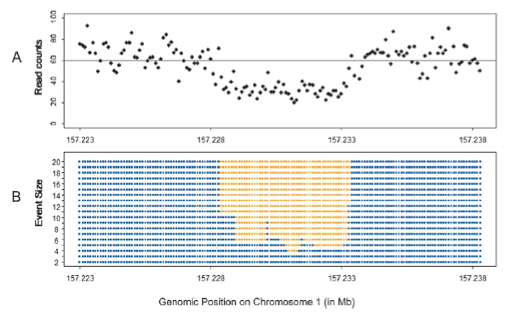
A Bit of History
A
Array
S
HTS
1
2
3
196x : Karyotype
1993 : Spectral Karotype (SKY)
199x : CGH on chromosomes
3
3
1 or 2
200x : cDNA/BAC-based CGH array
2005 : oligo-based
CGH array
201x : HTS Read depth
(WGS / WES)
A
S
A

Slide 9
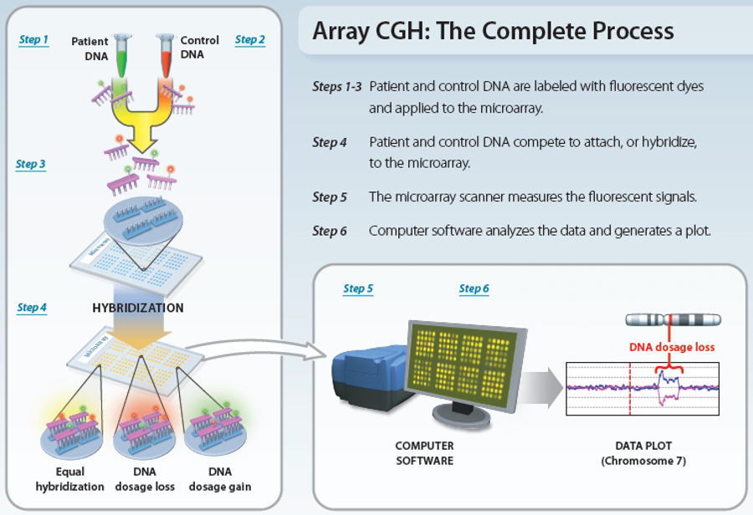
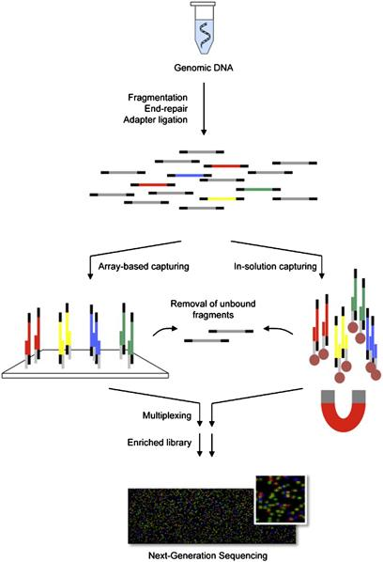
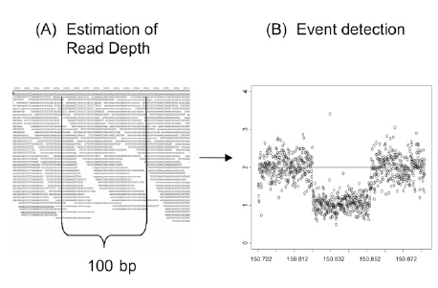
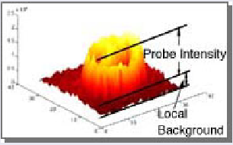
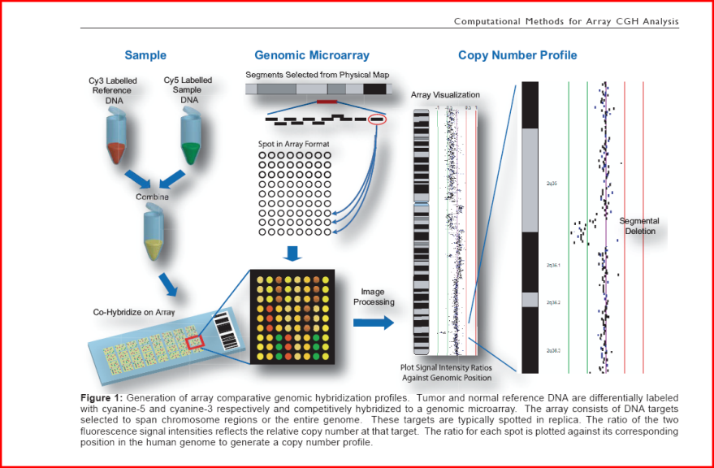
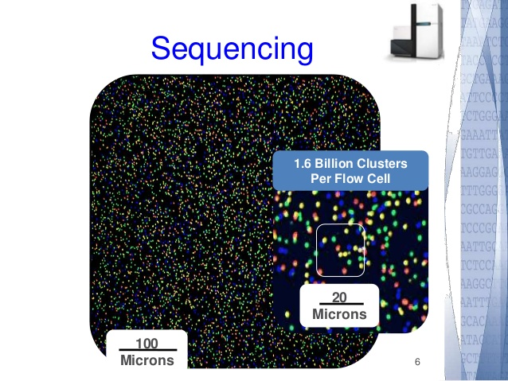
Technical Principle
A
S
Microarray
HTS
CNA Detection
TEST
REFERENCE
& SEQUENCES
Probe intensities
Read depths
0
Maps

Slide 10
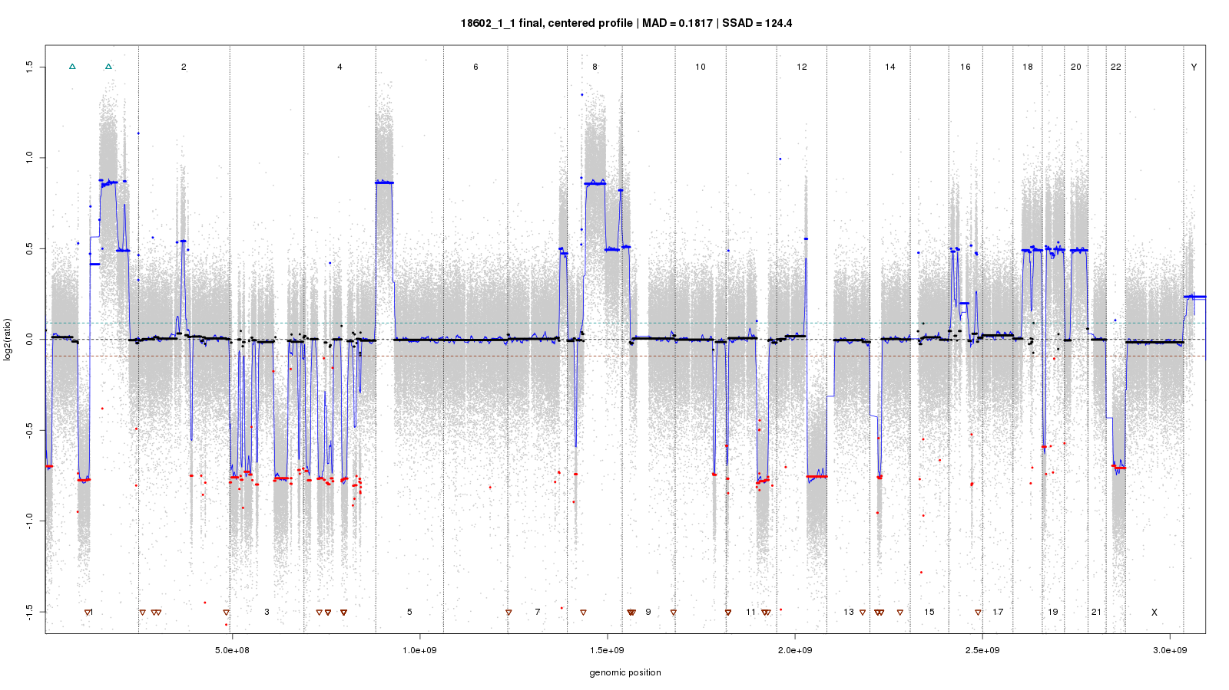
Our aim : a CNA profile (L2R)
A
S
‹#›

Slide 11
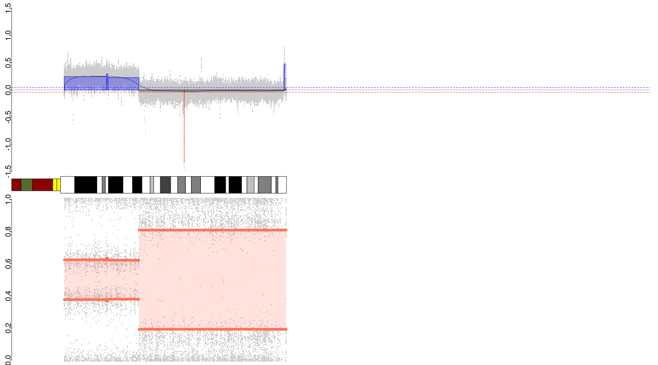
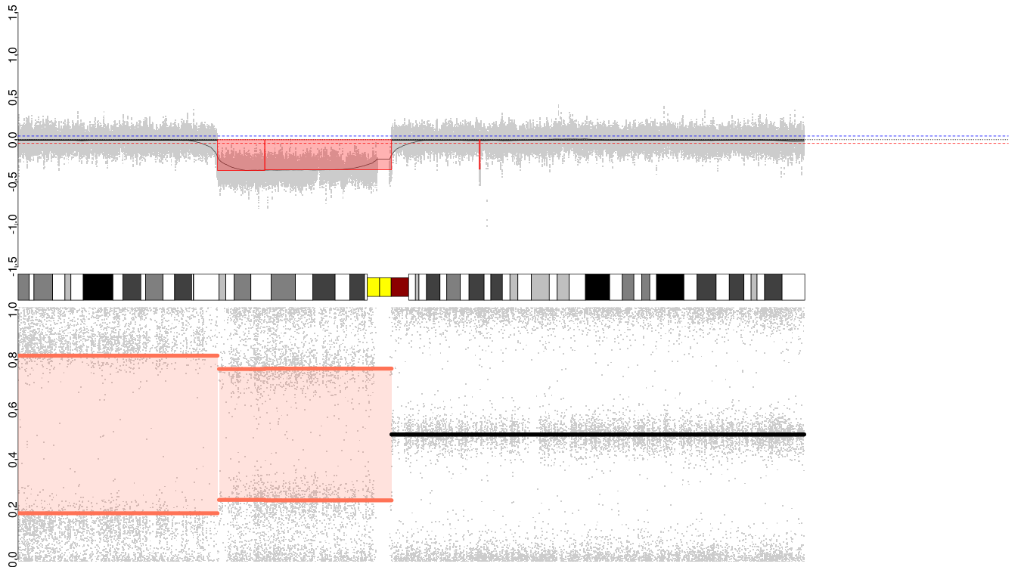
A Family of Events : Gain and Loss
First cases of abnormality

Slide 12
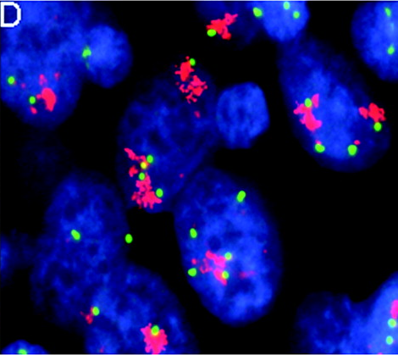
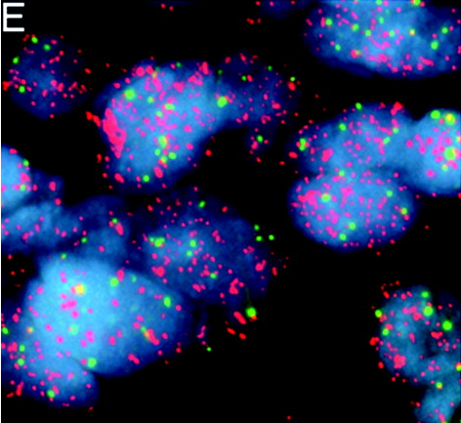
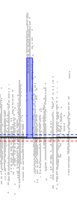
A Family of Events : Amplification
Extreme gain case
Theoretical level : L2R >= 1.5 :
3 additional copies from diploidy
3 + 2 = 5 copies
log2(5) ~= 1.58
rounded to 1.5
Classically focal event
Two sorts
Homogeneously stained regions (HSR) : multiple tandem
Double-minute chromosomes (up to thousands of copies)
EGFR amplification in lung cancer as HSR (homogeneously stained region)
EGFR amplification in lung cancer as double-minutes
Varella-Garcia et al, J Clin Pathol 2009

Slide 13
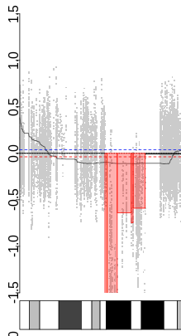
A Family of Events : Deletion
Extreme loss case (no remaining copy)

Slide 14
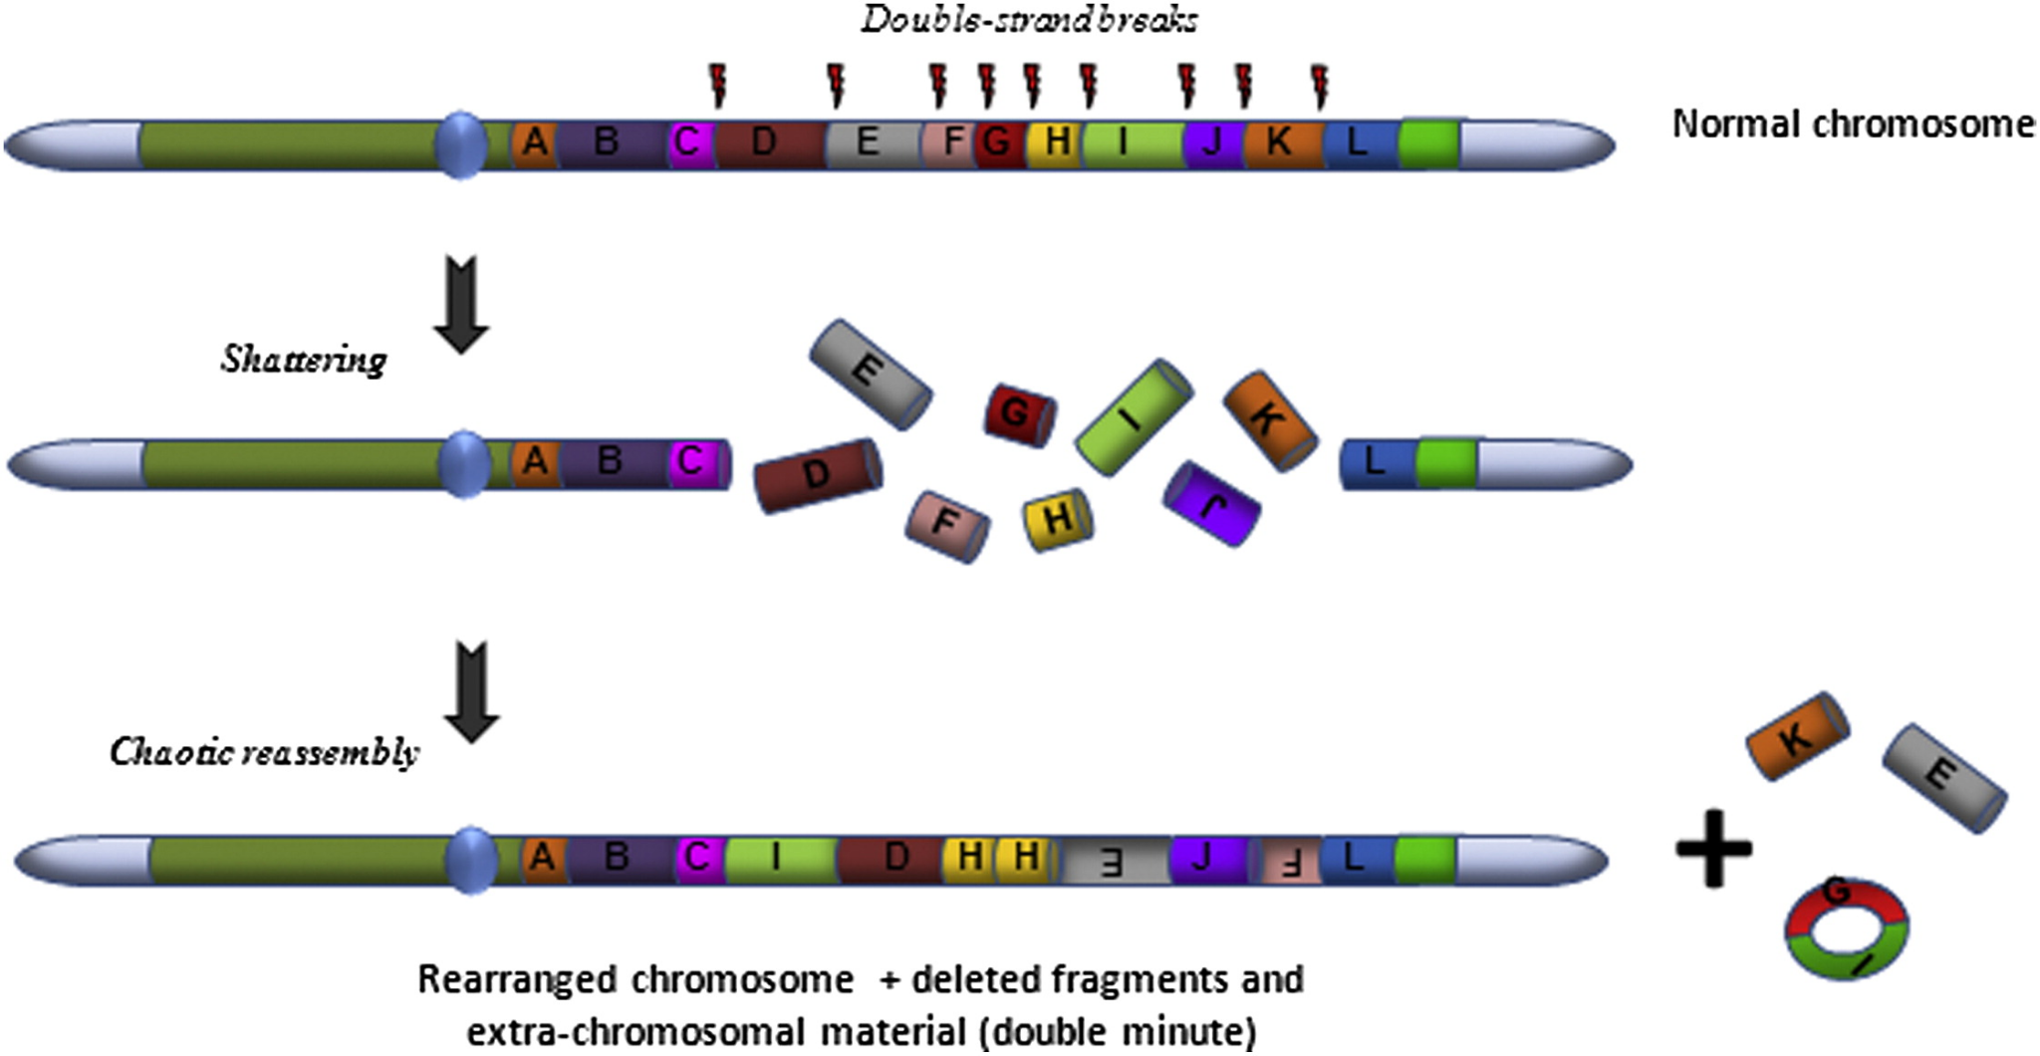
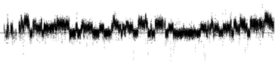
A Family of Events : Chromothripsis
Extreme, catastrophic event
Up to thousands of fragments involved
Single temporal event
Classically arm- or whole chromosome-level
Can result in external double-minute chromosomes
Alternance of 2, sometimes 3 copy levels
Few locations (up to two chromosomes)
If more locations : chromoplexy

Slide 15
A Family of Events : Loss of Heterozygosity
Measured using L2R and the local frequency of parental alleles (BAF, AD, beta-score), thanks to SNVs.
Quantitative loss of one of the two parental alleles : LOH
Obvious case : single copy loss or gain from an even ploidy
Extreme loss case : single copy loss from diploidy : haploidy
Not mandatorily a copy number event :
loss or gain of a parental allele, with completion from the other one : copy-neutral LOH
Extreme case : total loss of a parental allele, recovering using the remaining one : unisomy

Slide 16
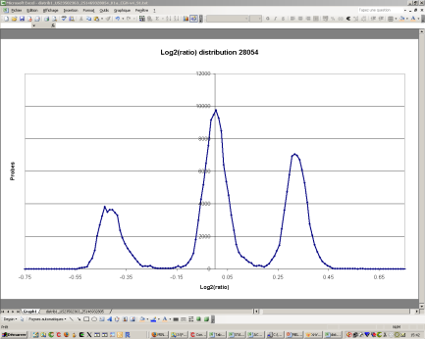
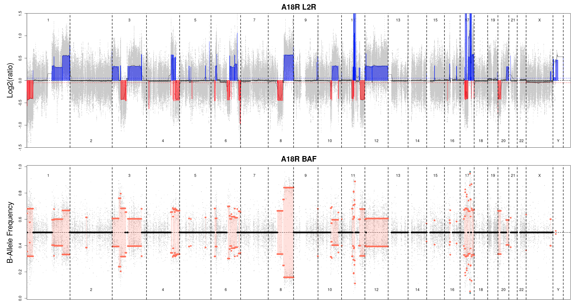
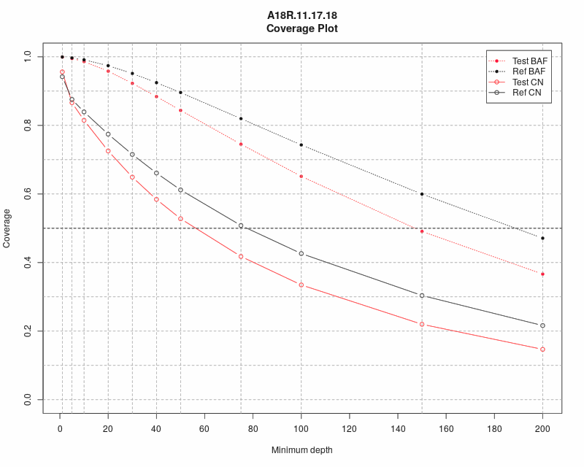
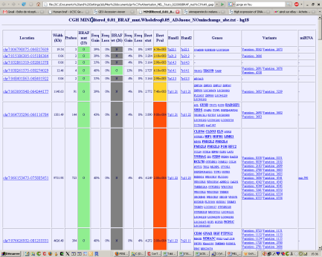
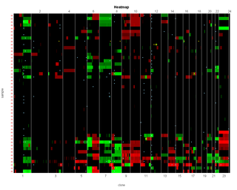
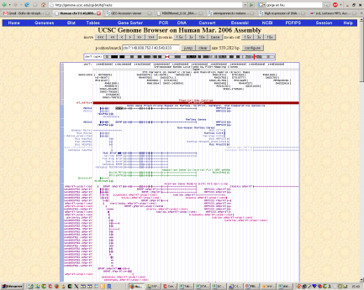
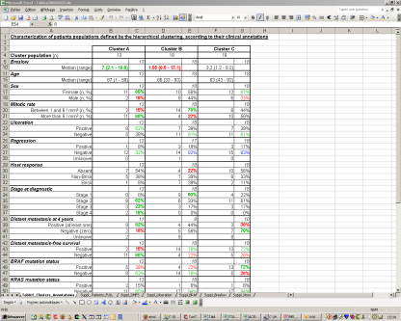
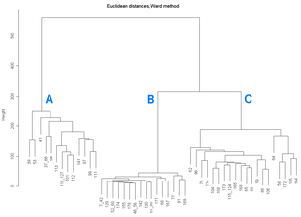
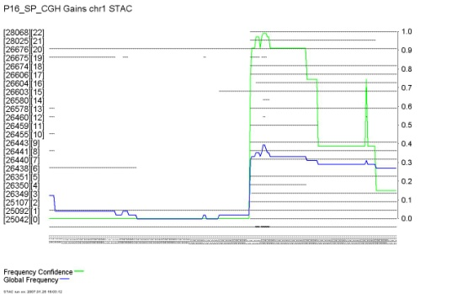
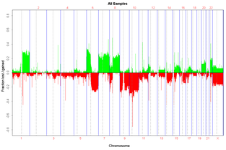
Analysis Workflow
Normalization,
centralization
Segmentation,
calling
Acquisition
Binning
+ QC
BAM
BAM
/
mpileup
Genomic regions of interest
Cohort analysis
Annotation

Slide 17
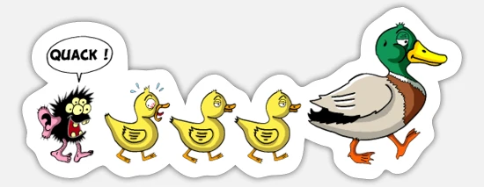
EaCoN
Bivariate segmentation (L2R + BAF), choice of 3 different algorithms : ASCAT, FACETS, SEQUENZA
Total (TCN) and allele-specific (ASCN) copy number modeling, ploidy and tumor cellularity estimation
Compatibility with WES and Affymetrix microarrays (SNP6, OncoScan family, CytoScan family)
From “raw” (BAMs / CELs) data to annotated segments
Rendering of a QC / results HTML report
Compatible with any genome that can be handled by BSgenome
Full R, quite recent (open source since 2018-05)
Built for bioinformaticians and researchers with starting R knowledge
Code / vignette : https://github.com/gustaveroussy/EaCoN
Pretty help : https://rdrr.io/github/gustaveroussy/EaCoN

Slide 18
Our Training Dataset
Data source : The Cancer Genome Atlas https://cancergenome.nih.gov/
Pathology : breast cancer (BRCA)
Sample name : BH-A18R
Sequencer : Illumina HiSeq 2000 (2011/05)
Sequencing kit : Illumina Paired-End 2 x 101 pb
Capture kit : “NIMBLEGEN exome version 2”
Mapper : BWA
Reference genome build : hs37d5 (≈ hg19 without “chr” in chr names)
Restrictions (for execution time) :
Reads from chr11, chr17 and chr18 only
Depth dropped to 20% of original (Tumor : 4,790,417 ; Normal : 5,643,177)

Slide 19
PRACTICE : Warm-up (IFB cluster)
# Requesting and interactive shell with needed resources
$ srun --cpus=4 --mem=16G -J session_<user_name> --pty bash
# *OR* open an interactive shell (terminal) in your Jupyter notebook (medium profile)
# Loading the already prepared EaCoN v0.3.5 execution environment
$ module load r-eacon/0.3.5
# Building a local directory for this training session and copying data
$ mkdir ~/tp_cna
$ cp -r /shared/projects/ebai2021_n2/data/dna_seq/cna/* ~/tp_cna
$ cd ~/tp_cna
# Building our output directory
$ mkdir -p ~/tp_cna/RESULTS/REDUX
# Opening and interactive R session
$ R

Slide 20
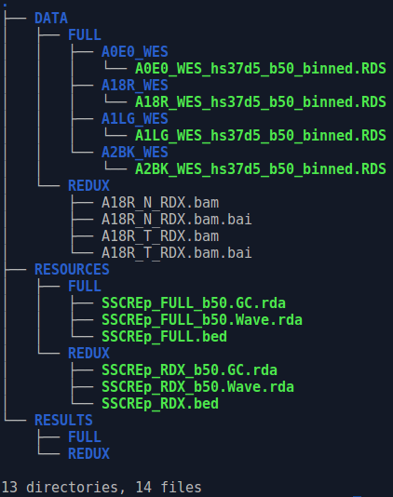
PRACTICE : Warm-up (R)
Once in R :
Move to your output directory
setwd("~/tp_cna/RESULTS/REDUX")
Charger le package EaCoN :
library(EaCoN)
Notes:
tree après la copie des données

Slide 21
Our aim : a CNA profile (L2R)
A
S
‹#›

Slide 22
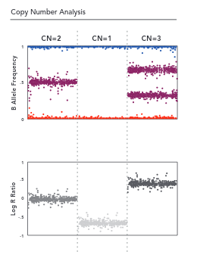
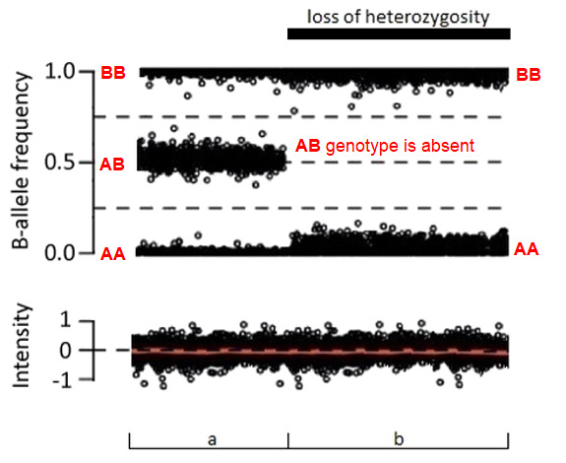
Our aim : a CNA profile (BAF)
A
S
REFERENCE
A T C A G T G C C A A T G T C
A T C C G T G C C A A T G T C
A T C C G T G C C G A T G T C
A T C C G T G C C A A T G T C
A T C C G T G C C G A T G T C
A T C C G T G C C G A T G T C
A T C C G T G C C A A T G T C
BB
BBB
READS
B
ABB
"B" COUNTS
6
3
TOTAL COUNTS
6
6
BAF
1
0.5
AAB
A
AA
AAA
‹#›

Slide 23
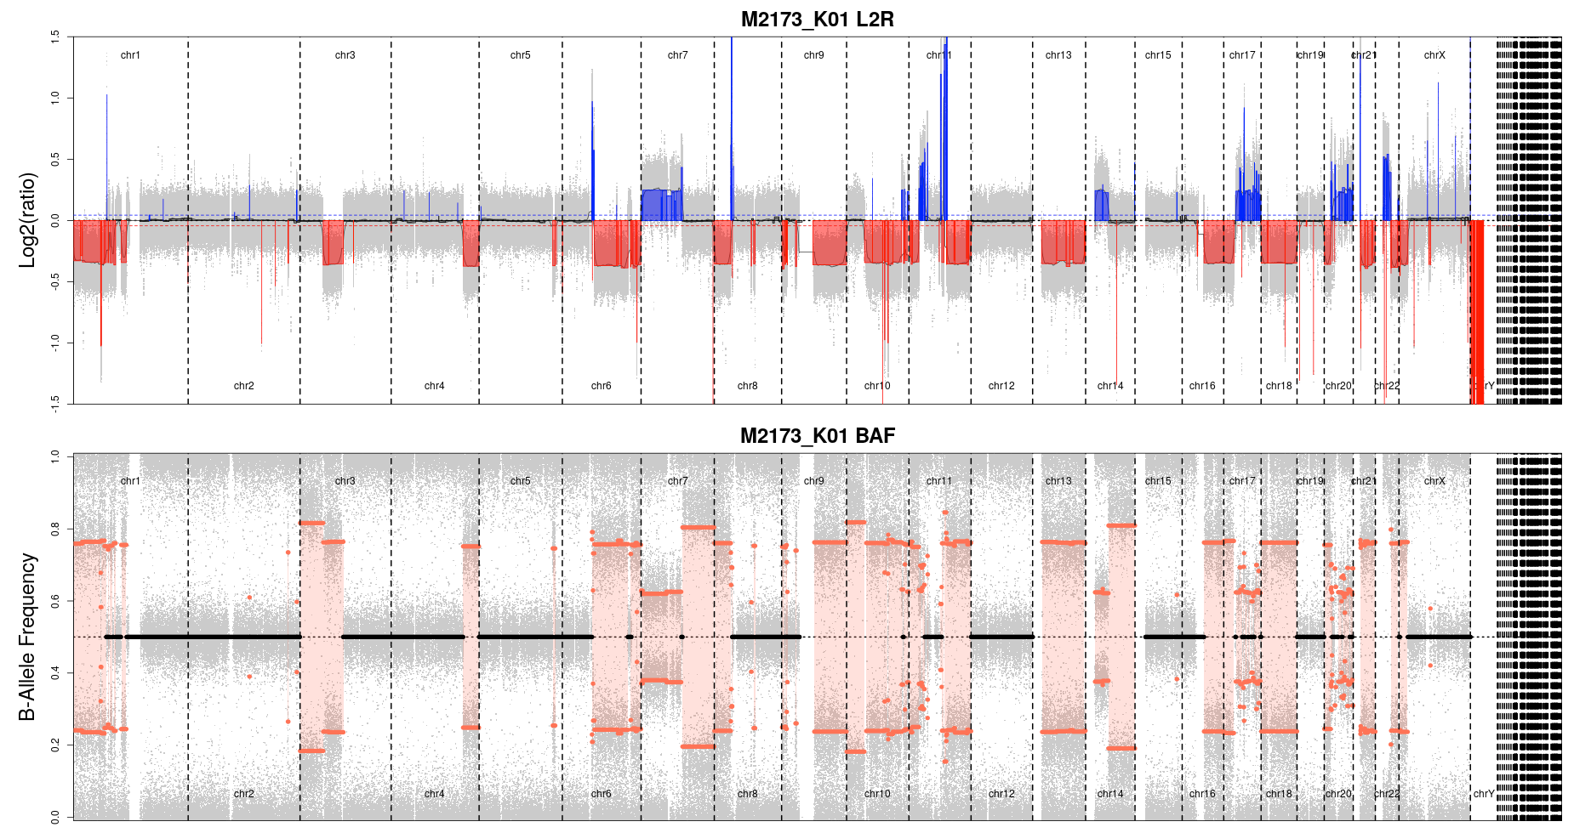
Our aim : a CNA profile
A
S
‹#›

Slide 24
Data Reduction
-
Binning

Slide 25
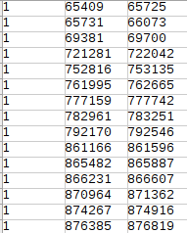
Data reduction (binning) : Why ?
WES = fragmented data by nature (capture)
Reduction is necessary :
Computational time. An example for hg19 WES :
→ Capture BED width ≈ 65 Mb
→ Reads ≈ 100 M, length ≈ 75 b
→ CPU times :
50 b bins (1 CPU) ≈ 5h
Without binning ≈ 50 x 5h = 250 h = 10j 10h !
Some incompatible methodologies. Ex : GC% normalisation :
→ Computed on windows (score 0 <> 100), impossible at the single nucleotide level (A or T = 0%, C or G = 100%)
Drawbacks :
Lowering the breakpoint precision
Notes:
Types de données et réduction

Slide 26
Data reduction (binning) : How ?
Source data : BAM files
Required data :
base-level depths
variants position and frequency
Tool : Rsamtools package
Allows to efficiently read from BAM files
Performs mpileup generation :
Converts into an easy to use R object
Additional steps :
Aggregating base-level depths to bins
Computing BAF values
Notes:
Types de données et réduction

Slide 27
Generating a “BINpack”
BED entries (exons ?) are :
split if > bin size
kept as is if < bin size
GC% computed using the genome sequence for different windows (both sides) around each bin coordinate
by default : 0, 50, 100, 200, 400, 800, 1600, 3200, 6400 b
Only done once per (bed + bin size + genome build) combo
Optionally include other bin-level tracks (ie : wave effect)
Results stored on disk into a RDS (R Data Storage) package
For our course, already prepared to spare few minutes of our time for something more interesting
HELP : ?BINpack.Maker

Slide 28
PRACTICE : Data binning
Input data files :
Test BAM (tumor) :
~/tp_cna/DATA/REDUX/A18R_T_RDX.bam
Reference BAM (normal, same patient) :
~/tp_cna/DATA/REDUX/A18R_N_RDX.bam
Precomputed BINpack :
~/tp_cna/RESOURCES/REDUX/SSCREp_RDX_b50.GC.rda
WES.Bin(testBAM = "~/tp_cna/DATA/REDUX/A18R_T_RDX.bam",
refBAM = "~/tp_cna/DATA/REDUX/A18R_N_RDX.bam",
BINpack = "~/tp_cna/RESOURCES/REDUX/SSCREp_RDX_b50.GC.rda",
samplename = "A18R.RDX", nsubthread = 3)
system("tree -sf")
HELP : ?WES.Bin
Notes:
3 chromosomes, 3 CPU
Temps local : 31 min / 10 min // Temps core : 70 min / 15 min
GO BACK SLIDE 3

Slide 29
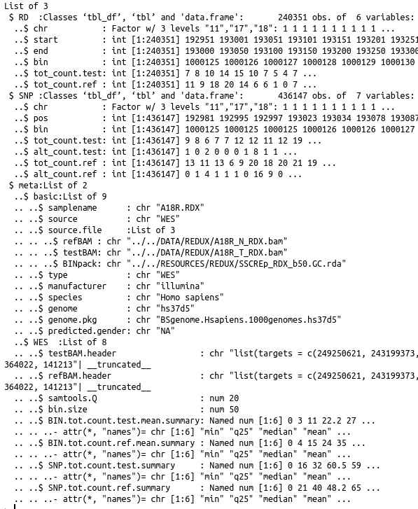
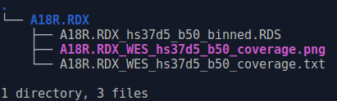
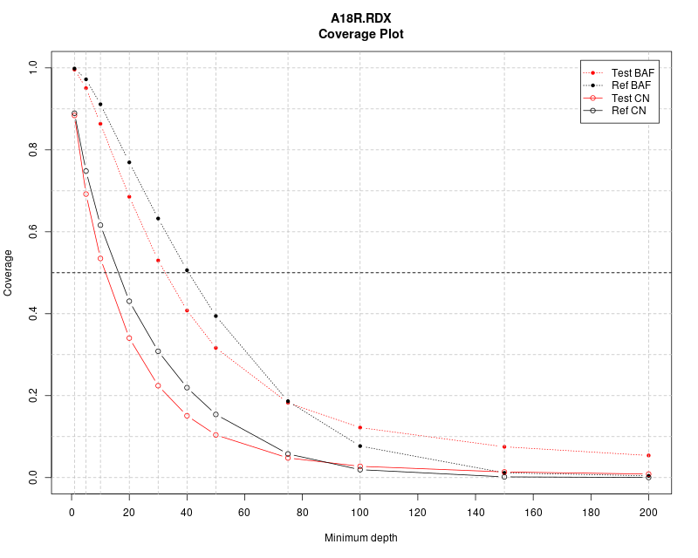
Data Binning : Outputs
Notes:
load(“../../RESOURCES/REDUX/SSCREp_RDX_b50.GC.rda)
str(renorm.data)

Slide 30
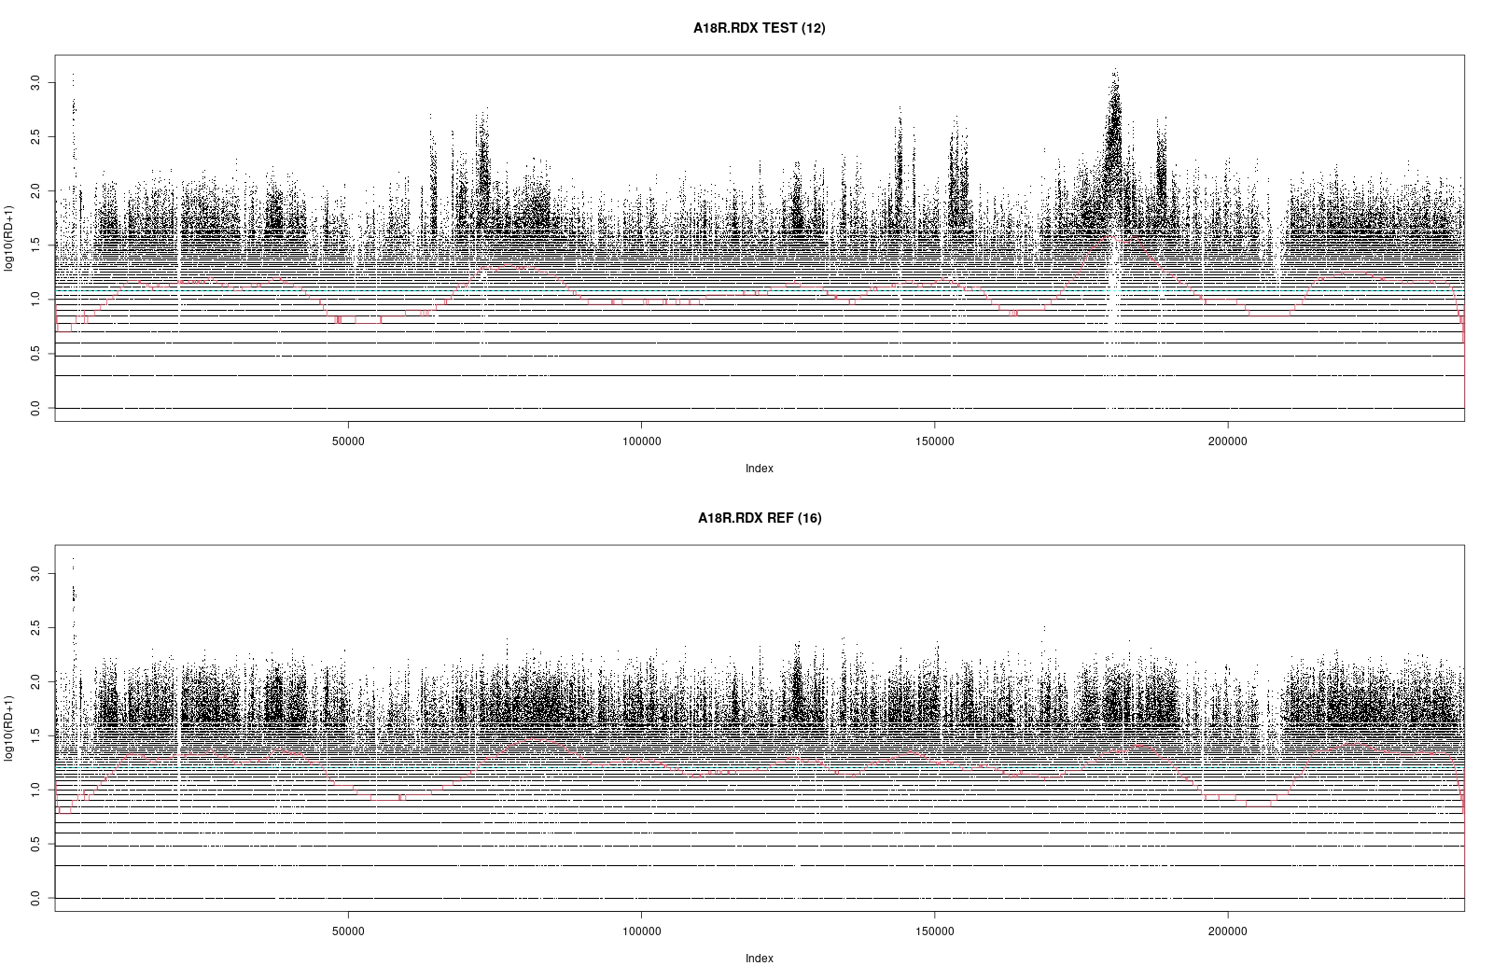
Data Binning : Outputs (QC : log10(depth))
Notes:
load(“../../RESOURCES/REDUX/SSCREp_RDX_b50.GC.rda)
str(renorm.data)

Slide 31
Normalization
-
Reducing sources of bias

Slide 32


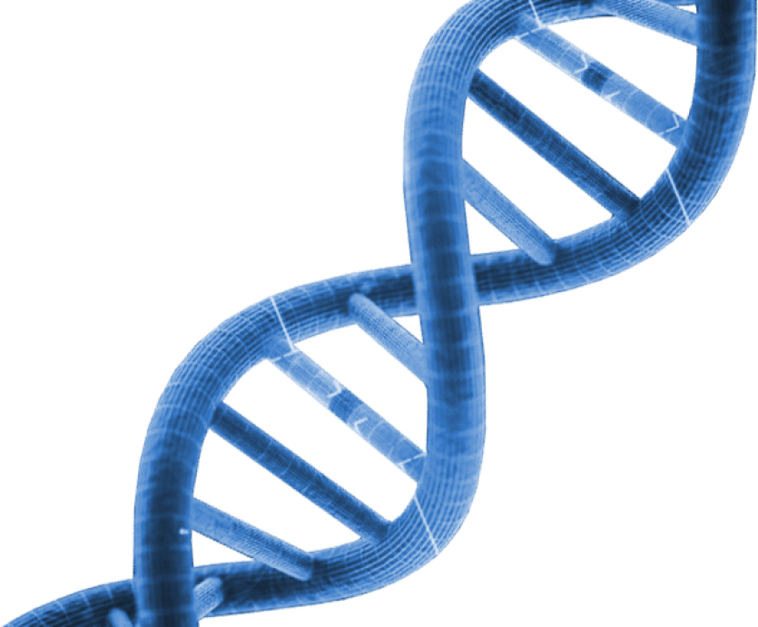
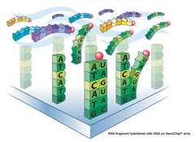
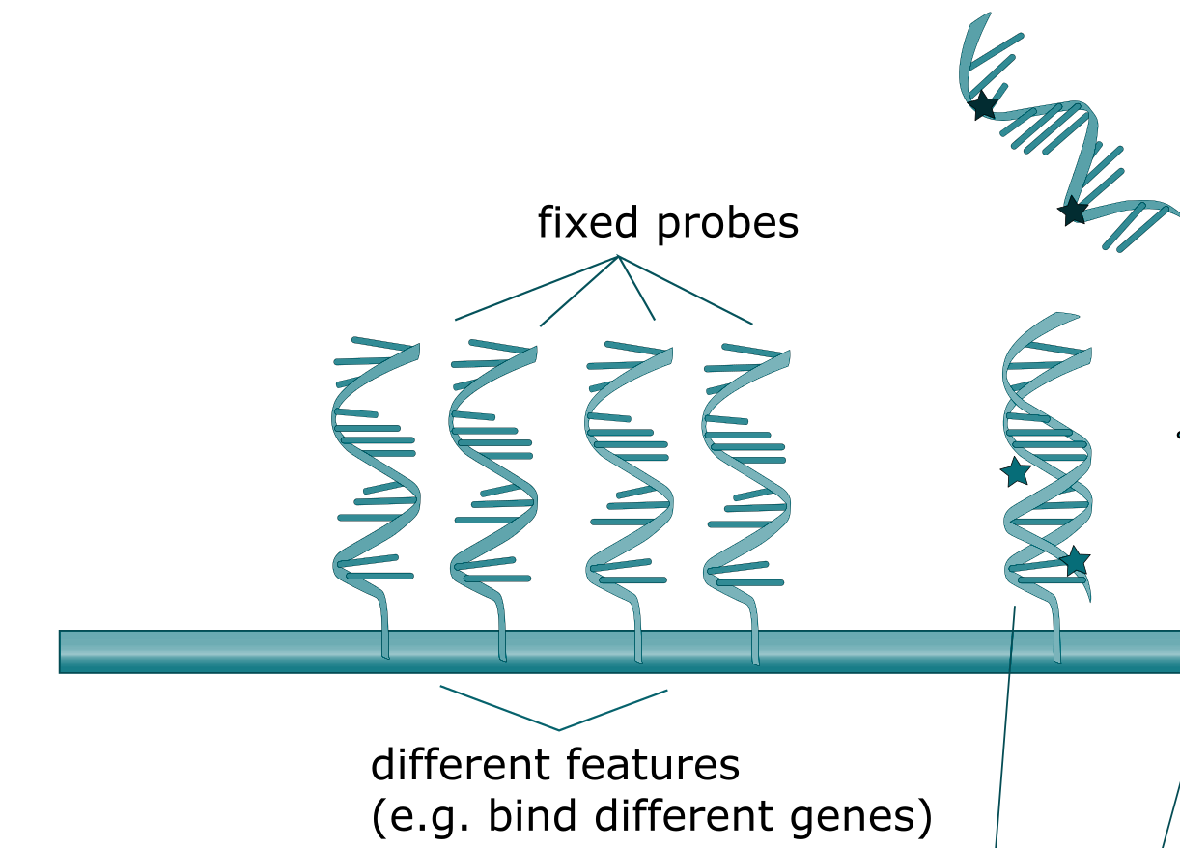
GC Bias ? Resolve an old case!
Genomic DNA is fragmented (restriction enzymes cocktail, sonication, fine needle shattering, FFPE, …)
… then labelled by random priming
… then melt and put to hybridization on microarray (see pictures on the left)
… then intensities are read (scan)
log2(test/ref) is computed
Regression of precomputed probes GC% (25 ~ 55 nt) versus log2ratio profile is performed
FAILURE ! (WHY ?)
© Wikipedia, 2021
‹#›

Slide 33
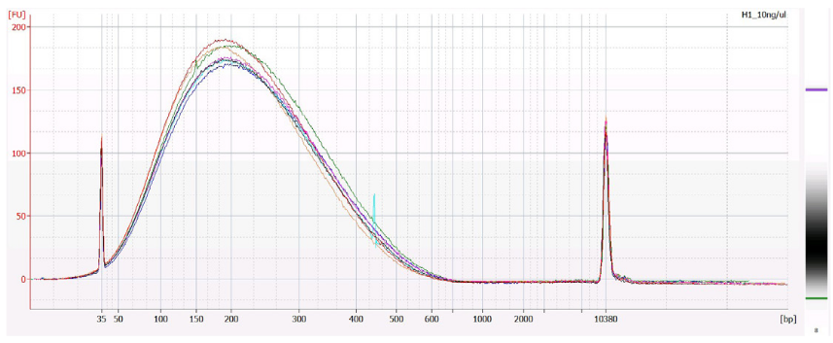
GC Bias ? Resolve an old case!
Labelled fragments are way longer than probes !
GC% to use is not the one from the probe, but from the longer generated DNA fragments
How ? Higher GC% : higher chance of auto-hybridization (shadowed signal : lower intensity / depth)
Took years (lost…) to figure it out !!
An epic example of the requirement of precise, detailed communication between lab researchers / techs and bioinformaticians
The culprit was colonel [figures], in the [poorly reviewed publications] using weapon [bad communication]
He’s still running... (cf Wikipedia plot)
X
X
© Wikipedia, 2021
‹#›

Slide 34
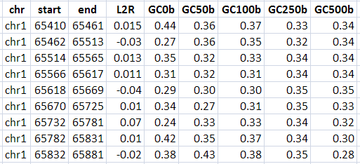
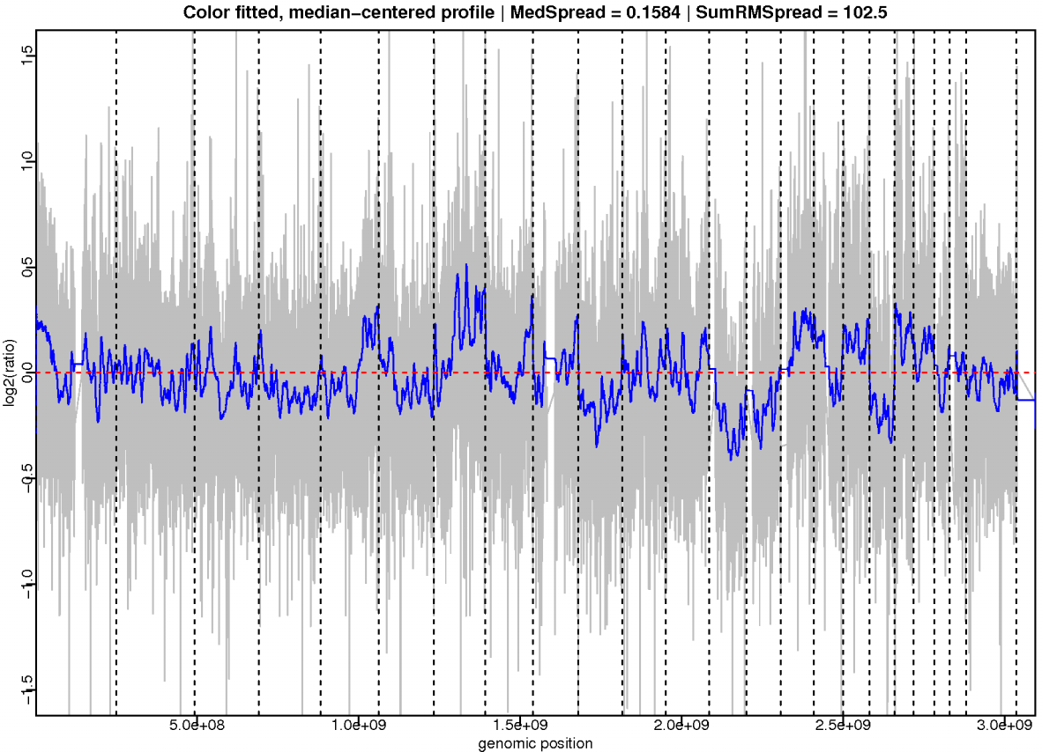
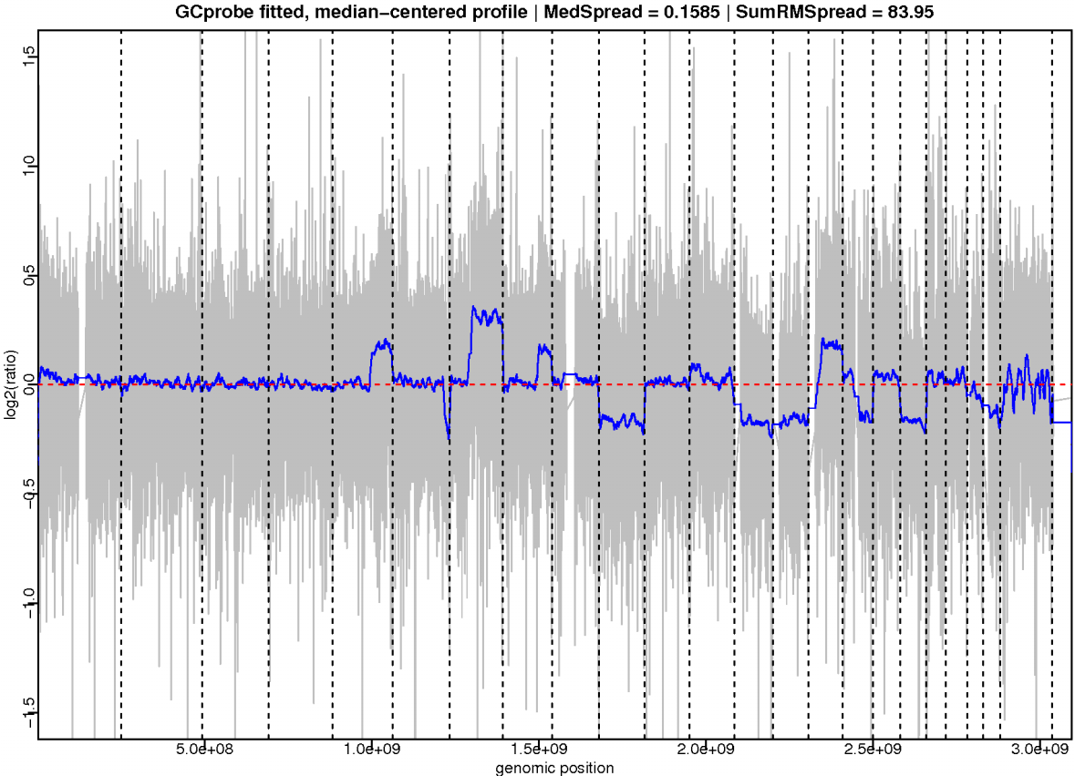

GC% Normalization by Recursive Lowess Regression
‹#›

Slide 35

Normalization : “Mappability” Probability
“Mappability” :
Genomic regions with notably few reads sequenced
First identified by occurrence, now modellized from genome composition (GEM)
Has effects on very low coverage BAMs only (<50x)
Ribeca et al., PLoS One, 2012

Slide 36


Normalization : “Wave effect”
Residual wavelets after all knowledge-base (GC%, mappability scores) normalizations
Corresponds to unknown sources of bias
Can occur at different levels in multiple samples : can be inferred !
R Package cghseg
5~10 samples minimum required
huge CPU/RAM/time resources required
Picard et al., Biostatistics, 2011

Slide 37

Centralization
-
Normality should always be the reference

Slide 38




Centralization : An Easy Synthetic Example
A
S
L2R distribution
Density
Log2(ratio)
Log2(ratio)
Chromosomes
‹#›

Slide 39



Centralization : A Real-life Cancer Example
A
S
L2R distribution
?
?
Density
?
?
?
Log2(ratio)
Log2(ratio)
Chromosomes
‹#›

Slide 40


Centralization : Centrality / Density Trade-off
A
S
Centrality
Population
‹#›

Slide 41
PRACTICE : Normalization & Centralization
Input data :
The binned data you generated :
~/tp_cna/RESULTS/REDUX/A18R.RDX/A18R.RDX_hs37d5_b50_binned.RDS
Precomputed GC% tracks from the BINpack :
~/tp_cna/RESOURCES/REDUX/SSCREp_RDX_b50.GC.rda
Precomputed “Wave” tracks from public datasets :
~/tp_cna/RESOURCES/REDUX/SSCREp_RDX_b50.Wave.rda
WES.Normalize.ff(BIN.RDS.file = "A18R.RDX/A18R.RDX_hs37d5_b50_binned.RDS", BINpack = "~/tp_cna/RESOURCES/REDUX/SSCREp_RDX_b50.GC.rda",
wave.rda = "~/tp_cna/RESOURCES/REDUX/SSCREp_RDX_b50.Wave.rda",
wave.renorm = TRUE)
system("tree -sh")
HELP : ?WES.Normalize.ff ?WES.Normalize
Notes:
Temps local : 16s
Temps core : 30s

Slide 42


PRACTICE : Outputs

Slide 43
Segmentation
-
From numerous, noisy, and punctual local measures to limited, denoised and larger genomic intervals

Slide 44


Segmentation (and calling)
Segmentation = longitudinal data reduction
From numerous, punctual, noisy, technical measures (bins) ...
… to limited, continuous intervals with a single value and closer to the biological reality
Calling = defining the limits of normality
M = 100
S = 4

Slide 45



Segmentation : Numerous Tools Available ...
Duan et al.
Plos One
2013
Zare et al.
BMC Bioinformatics
2017
… and a very poor consensus
Gain
Loss

Slide 46
PRACTICE : Segmentation and calling [ASCAT]
Input data :
The normalized data RDS you generated :
~/tp_cna/RESULTS/REDUX/A18R.RDX/A18R.RDX_hs37d5_b50_processed.RDS
Segment.ff(RDS.file = "A18R.RDX/A18R.RDX_hs37d5_b50_processed.RDS", segmenter = "ASCAT", smooth.k = 5, nrf = 10, SER.pen = 5)
HELP : ?Segment.ff ?Segment.ASCAT
Notes:
Temps local : 24s
Tempc core : 76s

Slide 47

PRACTICE : Outputs [ASCAT]

Slide 48

Name these event types !
1
2
4
3
7
6
5
‹#›

Slide 49

Name these putative event cases !
1. chr2
‹#›

Slide 50
Name these putative event cases !
1. chr2 : NORMALITY
‹#›

Slide 51

Name these putative event cases !
2. chr7
‹#›

Slide 52
Name these putative event cases !
2. chr7 : GAIN
‹#›

Slide 53

Name these putative event cases !
3. chr11
‹#›

Slide 54
Name these putative event cases !
3. chr11 : AMPLIFICATION
‹#›

Slide 55

Name these putative event cases !
4. chr9
‹#›

Slide 56
Name these putative event cases !
4. chr9 : LOSS
‹#›

Slide 57

Name these putative event cases !
5. chrY
‹#›

Slide 58
Name these putative event cases !
5. chrY : DELETION
‹#›

Slide 59




Name these putative event cases !
5. chr1/9/10/11/17/20
‹#›

Slide 60
Name these putative event cases !
5. chr1/9/10/11/17/20 : CHROMOPLEXY
‹#›

Slide 61


Name these putative event cases !
7. chr3/7/14/22
Part of chr1 for reference
‹#›

Slide 62
Name these putative event cases !
7. chr3/7/14/22 : UNISOMY
Part of chr1 for reference
‹#›

Slide 63
Total Copy Number
-
Beyond the L2R Profile

Slide 64
Using Both L2R and BAF

Slide 65

Modelization of Absolute Copy Number
A mathematical combination of L2R and BAF/AD signals
Popova et al., Cancer Res, 2016

Slide 66


Estimation of Global Ploidy and Cellularity
Ploidy : Width-ponderated TCN
Cellularity : dilution of L2R/BAF signals

Slide 67
PRACTICE : Absolute Copy Number [ASCAT]
Input data :
The segmented data you generated :
~/tp_cna/RESULTS/REDUX/A18R.RDX/ASCAT/L2R/A18R.RDX.SEG.ASCAT.RDS
ASCN.ff(RDS.file = "A18R.RDX/ASCAT/L2R/A18R.RDX.SEG.ASCAT.RDS", nsubthread = 3)
system("tree -sh")
HELP : ?ASCN.ff ?ASCN.ASCAT
Notes:
Utilisation des 4 coeurs disponibles pour calculer l’ensemble des itérations gamma
Temps local :
Temps core : 76s

Slide 68

PRACTICE : Outputs [ASCAT]

Slide 69
PRACTICE : Annotation and HTML Report [ASCAT]
Input data :
The segmented data you generated :
~/tp_cna/RESULTS/REDUX/A18R.RDX/ASCAT/L2R/A18R.RDX.SEG.ASCAT.RDS
Annotate.ff(RDS.file = "A18R.RDX/ASCAT/L2R/A18R.RDX.SEG.ASCAT.RDS")
system(“tree -sh”)
HELP : ?Annotate.ff ?Annotate

Slide 70

PRACTICE : Outputs [ASCAT]

Slide 71
BONUS 1
-
Segmentation of Complete WES Data

Slide 72
PRACTICE : Complete Pre-normalized WES Data [ASCAT]
p
Input data :
Binned datasets
“GC%” & “Wave” packs corresponding to all WES regions
Exercise :
In a shell, copy the content of ~/tp_cna/DATA/FULL into ~/tp_cna/RESULTS/FULL
In R/Rstudio, set the working directory to ~/tp_cna/RESULTS/FULL/
Reproduced all the analysis steps performed earlierly (since normalization) on these samples, still using ASCAT.

Slide 73
PRACTICE : Complete Pre-normalized WES Data [ASCAT]
To make it faster, we will perform it using multiple threads (CPUs)
WES.Normalize.ff.Batch(BINpack = "~/tp_cna/RESOURCES/FULL/SSCREp_FULL_b50.GC.rda", wave.rda = "~/tp_cna/RESOURCES/FULL/SSCREp_FULL_b50.Wave.rda", wave.renorm = TRUE, nthread = 4)
Segment.ff.Batch(segmenter = "ASCAT", smooth.k = 5, nrf = 1, SER.pen = 5, nthread = 4)
ASCN.ff.Batch(RDS.files = list.files(pattern = "SEG.ASCAT.RDS", recursive = TRUE), nthread = 4)
WARNING : DO NOT use the nsubthread parameter seen in your preceding use of the ASCN.ff() function : this would run the analysis using 4 x 4 = 16 CPUs, but you did not requested it to the le cluster scheduler !
Annotate.ff.Batch(RDS.files = list.files(pattern = "SEG.ASCAT.RDS", recursive = TRUE), nthread = 4)

Slide 74
BONUS 2
-
Comparison with microarray profiles

Slide 75
PRACTICE : Affymetrix snp6.0 Microarrays Results
BONUS
Result files :
/shared/projects/ebai2021_n2/correction/dna_seq/tp_cna/SNP6/A0E0_snp6/
/shared/projects/ebai2021_n2/correction/dna_seq/tp_cna/SNP6/A18R_snp6/
/shared/projects/ebai2021_n2/correction/dna_seq/tp_cna/SNP6/A1LG_snp6/
/shared/projects/ebai2021_n2/correction/dna_seq/tp_cna/SNP6/A2BK_snp6/
Exercise :
Compare, thanks to plots and the HTML report, the segmentation results obtained from WES and SNP6 for the same samples.
NOTE : Expected WES results are also available here :
/shared/projects/ebai2021_n2/correction/dna_seq/tp_cna/WES/REDUX/
/shared/projects/ebai2021_n2/correction/dna_seq/tp_cna/WES/FULL/

Slide 76
BONUS 2
-
WES with another segmenter : FACETS

Slide 77
PRACTICE : Segmentation & calling [FACETS]
BONUS
Input data :
The normalized RDS dataset :
~/tp_cna/RESULTS/REDUX/A18R.RDX/A18R.RDX_hs37d5_b50_processed.RDS
Run this command in R (same as with ASCAT, changing the segmenter parameter) :
Segment.ff(RDS.file = "A18R.RDX/A18R.RDX_hs37d5_b50_processed.RDS", segmenter = "FACETS", smooth.k = 5, nrf = 1, SER.pen = 5)
HELP : ?Segment.ff ?Segment.FACETS
Notes:
Temps local :
Temps core : 51s

Slide 78

PRACTICE : Outputs [FACETS]
BONUS

Slide 79
PRACTICE : Absolute Copy Number [FACETS]
BONUS
Input data :
The segmented dataset you generated :
~/tp_cna/RESULTS/REDUX/A18R.RDX/FACETS/L2R/A18R.RDX.SEG.FACETS.RDS
Run in R (same as with ASCAT) :
ASCN.ff(RDS.file = "A18R.RDX/FACETS/L2R/A18R.RDX.SEG.FACETS.RDS")
HELP : ?ASCN.ff ?ASCN.FACETS

Slide 80

PRACTICE : Outputs [FACETS]
BONUS

Slide 81
PRACTICE: Annotation & HTML Report
BONUS
Input data :
The segmented dataset you generated :
~/tp_cna/RESULTS/REDUX/A18R.RDX/FACETS/L2R/A18R.RDX.SEG.FACETS.RDS
Run in R (same as with ASCAT) :
Annotate.ff(RDS.file = "A18R.RDX/FACETS/L2R/A18R.RDX.SEG.FACETS.RDS")
(you can also try the 3 other samples !)
HELP : ?Annotate.ff ?Annotate

Slide 82
BONUS 3
-
WES with another segmenter : SEQUENZA

Slide 83
PRACTICE : Segmentation & calling [SEQUENZA]
BONUS
Input data :
The normalized RDS dataset :
~/tp_cna/RESULTS/REDUX/A18R.RDX/A18R.RDX_hs37d5_b50_processed.RDS
Segment.ff(RDS.file = "A18R.RDX/A18R.RDX_hs37d5_b50_processed.RDS", segmenter = "SEQUENZA", smooth.k = 5, nrf = 1, SER.pen = 5)
HELP : ?Segment.ff ?Segment.SEQUENZA
Notes:
Test du 3e segmenteur

Slide 84
PRACTICE : Absolute Copy Number [SEQUENZA]
BONUS
Input data :
The segmented dataset you generated :
~/tp_cna/RESULTS/REDUX/A18R.RDX/SEQUENZA/L2R/A18R.RDX.SEG.SEQUENZA.RDS
ASCN.ff(RDS.file = "A18R.RDX/SEQUENZA/L2R/A18R.RDX.SEG.SEQUENZA.RDS")
HELP : ?ASCN.ff ?ASCN.SEQUENZA
Notes:
Test du 3e modélisateur CN

Slide 85
PRACTICE : Annotation & HTML Report
BONUS
Input data :
The segmented dataset you generated :
~/tp_cna/RESULTS/REDUX/A18R.RDX/SEQUENZA/L2R/A18R.RDX.SEG.SEQUENZA.RDS
Annotate.ff(RDS.file = "A18R.RDX/SEQUENZA/L2R/A18R.RDX.SEG.SEQUENZA.RDS")
(and you can still play with the 3 other samples !)
HELP : ?Annotate.ff ?Annotate

Slide 86
APPENDIX

Slide 87

Normalization : Source (Dye / Library / Run …) Bias
A
S
TEST
REFERENCE
‹#›

Slide 88





Normalization : Spatial Bias Sources
A
S
Gradient
Spotter
Print-tip
Leak
Density
‹#›

Slide 89

Normalization : Spatial Bias Correction
A
‹#›

Slide 90


Segmentation : A Computational Challenge
A
S
Two unknowns for breakpoints :
Localization
Quantity
Three families of algorithms :
Smoothers (wavelet)
Change-point
Binary segmentation (CBS)
Optimal partitionning (PELT)
HMM modeling (bioHMM)
Homoscedastic (m)
Heteroscedastic (m, V)
‹#›

Slide 91



Segmentation : Variations in Complexity
A
S
Ependymoma
Neuroblastoma
Osteosarcoma
‹#›

Slide 92
NGS Beyond Microarrays

Slide 93


NGS : Low Input, FFPE
S
Wood, 2010
FFPE (Formalin-fixed paraffin-embedded) samples
2 to 5 ng of DNA
‹#›

Slide 94

NGS : Cell-free DNA Shallow WGS
S
IchorCNA (Adalsteisson, Nature Com, 2017)
Cell-free DNA
ULP-WGS
0.1X coverage
‹#›

Slide 95


NGS : Cell-free DNA shallow WGS
S
WisecondorX (Raman et al, NAR, 2018)
‹#›

Slide 96



NGS : Single Cell CNA (SCOPE)
SCOPE Rujn Wang et al., bioRxiv, 2019/03
WARNING :
Limited resolution : > 2 Mb (binning)
Requires > 750,000 reads / cell
‹#›

Slide 97


NGS : Single Cell CNA from scRNAseq (InferCNV / CaSpER)
InferCNV (Broad Institute)
CaSpER (Armanci et al, BioRxiv 2019)
WARNING :
Coarse grain (> 10 Mb)
Requires > 75,000 reads / cell
‹#›

Slide 98

WGS : Intra-chromosomal Structural Variations
S
Courtesy of Bruno Zeitouni
‹#›

Slide 99

WGS : Inter-chromosomal Structural Variations
S
Courtesy of Bruno Zeitouni
‹#›

Slide 100


Visualization : Circos-plots
S
‹#›

Slide 101
NGS vs Microarrays
A
S
 | Microarray | NGS (WES / WGS)
Physical entity | Array on a glass slide | Lane in a flowcell
Measurement entity | Spot of probes | Cluster of fragments
Measurement unit | Luminous intensity per genomic position | Read depth per genomic bin
Data distribution | Log-normal | Negative binomial
Data transformation | Log ratio of intensities Test / Ref | Log ratio of depths Test / Ref
Bias main sources | Spatial effects, dye, GC-content | Library effects, spatial effects, coverage, GC-content, mappability
CNV information | Normality, gains and losses relative to the reference | Normality, gains and losses relative to the reference, absolute and allele-specific copy number levels
CNV event precision | Up to ~3 Kb | ~50 b
Structural information | Large-scale deletions | Insertions, deletions, inversions, balanced translocations
SNP information | Known SNPs (if specific probes) | All kinds of SNPs, position and allele frequency
SNV (mutation) information | No / some* | All SNVs
Sequence information | No | Full covered sequence
‹#›

Slide 102

Microarrays are still alive !

Slide 103


FFPE Samples
A
Affymetrix OncoScan

Slide 104


ctDNA
A
Affymetrix OncoScan

Slide 105


Ascite DNA
A
Affymetrix OncoScan

Slide 106
Further Analyses

Slide 107

Comparison of a Pair of Profiles (scaling)
A
S
d0
d21
‹#›

Slide 108

Comparison of a Pair of Profiles (scaled)
A
S
d0
d21
‹#›

Slide 109


Minimal Common Regions (MCR)
A
S
Mermel et al, Genome Biology, 2011
GISTIC2, BROAD Institute
‹#›

Slide 110

Hierarchical Clustering, Heatmap, Frequency of Aberrations, Genomic Instability Scores
A
S
‹#›

Slide 111


Other Clustering Methods
A
S
Non-negative Matrix Factorization
K-means
‹#›

Slide 112

Differential Analysis (in Subpopulations)
A
S
‹#›

Slide 113

Annotation of Genomic Regions
A
S
‹#›

Slide 114
Sample Classes and Clinical Variables
A
S
 | Hclust A |  | Hclust B |  | Hclust C
Stage at diagnostic |  | 13 |  | 16 |  | 20
Stage 1 | 0 | 0% | 9 | 56% | 4 | 20%
Stage 2 | 8 | 62% | 4 | 25% | 13 | 65%
Stage 3 | 3 | 23% | 3 | 19% | 3 | 15%
Stage 4 | 2 | 15% | 0 | 0% | 0 | 0%
Distant metastasis at 4 years |  | 11 |  | 8 |  | 11
Positive (at least one) | 9 | 82% | 4 | 50% | 3 | 27%
Negative (zero) | 2 | 18% | 4 | 50% | 8 | 73%
Distant metastasis-free survival |  | 13 |  | 16 |  | 20
Positive | 2 | 15% | 12 | 75% | 15 | 75%
Negative | 11 | 85% | 4 | 25% | 5 | 25%
Death |  | 13 |  | 15 |  | 19
Positive | 10 | 77% | 6 | 40% | 9 | 47%
Negative | 3 | 23% | 9 | 60% | 10 | 53%
‹#›

Slide 115

CNA + GEX : Associative Analysis (correlation)
A
S
‹#›

Slide 116



CNA + GEX : Associative Analysis (correlation)
A
S
‹#›

Slide 117


CNA + GEX : Integrative Analysis (multiblocs)
RGCCA, SGCCA
A
S
Philippe et Tenenhaus, Biostatistics, 2014
‹#›

Slide 118

CNA + GEX : Integrative Analysis (factorial)
A
S
Arguelaget et al. 2018
‹#›

